Slide 1
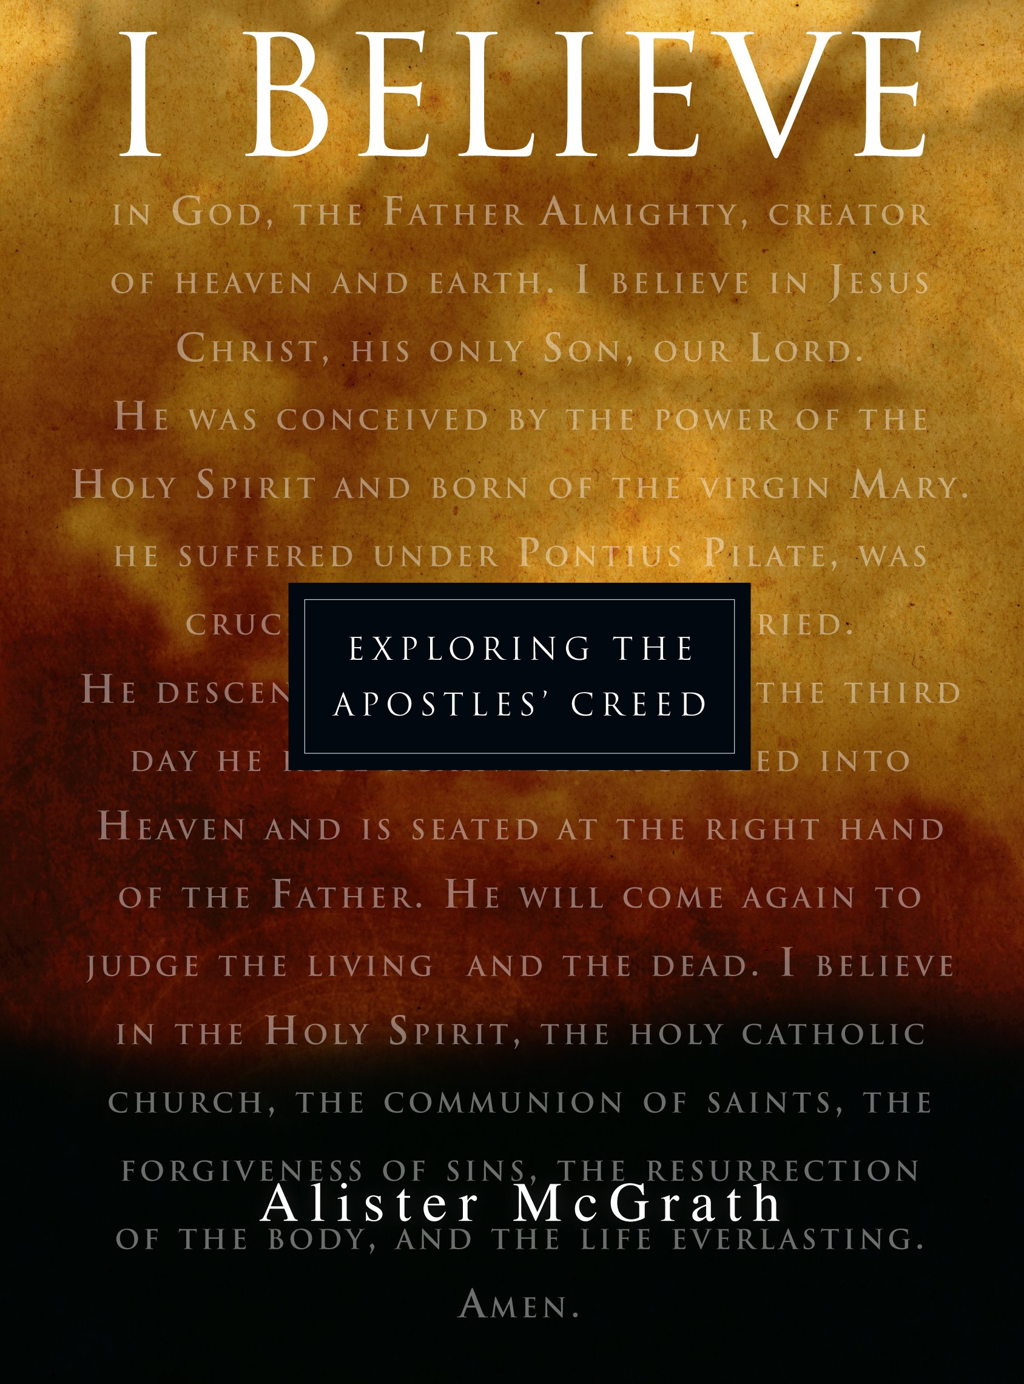
Apostles’ Creed
Articles 7-9

Slide 2
Article 7: FROM THERE HE WILL COME TO JUDGE THE LIVING AND THE DEAD

Slide 3
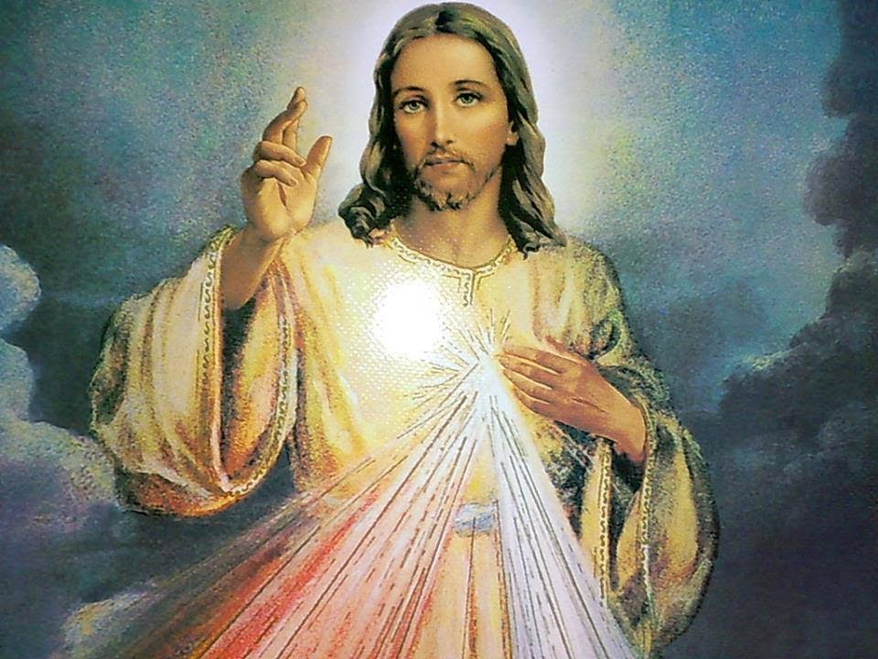
JESUS AS JUDGE
2 Judgments:
Particular Judgment
General Judgement

Slide 4
Particular Judgment
Occurs at moment of your death, when your immortal soul separates from your body
You will immediately appear in presence of God
Asked to give an account of your life:
- All your thoughts, words, and actions

Slide 5
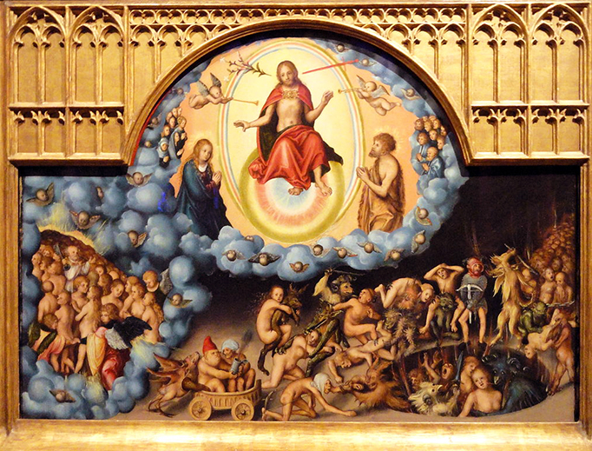
General Judgment
Standing before the just judge and in the presence of a congregated world to receive final judgement.
- Heaven: Reward of the Just
Council of Florence (1439)
- Hell: Punishment of the wicked
The Four Last Things

Slide 6
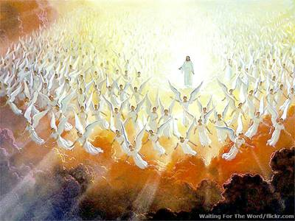
Council of Florence
The souls of the perfectly just will “clearly behold the Triune and One God as He is, but corresponding to the difference of their merits, the one more perfectly than the other”.

Slide 7
The Last Judgment
“But when the Son of Man shall come in his majesty, and all the angels with him, then He will sit on His glorious throne. All the nations will be gathered before Him; and He will separate them from one another, as the shepherd separates the sheep from the goats; and He will put the sheep on His right, and the goats on the left.”
Matthew 25:31-33

Slide 8
The Last Judgment
“Then the King will say to those on His right, ‘Come, you who are blessed of My Father, inherit the kingdom prepared for you from the foundation of the world.”
Matthew 25:34
“Then He will also say to those on His left, ‘Depart from Me, accursed ones, into the eternal fire which has been prepared for the devil and his angels.”
Matthew 25:41

Slide 9
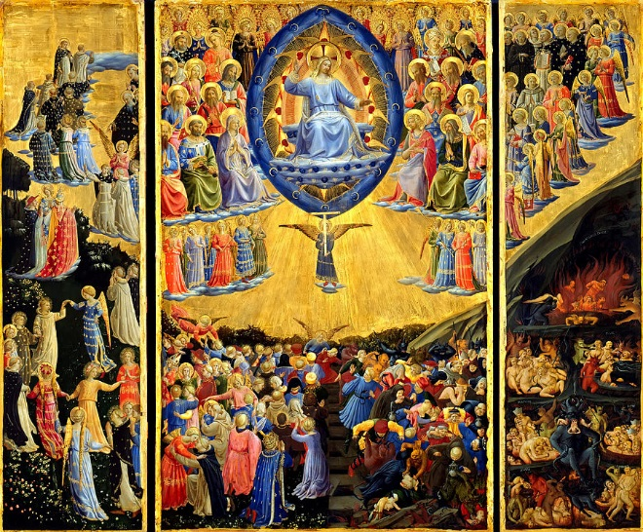
The Last Judgment

Slide 10
Why a General Judgment?
To Understand how our actions affected others:
Ripple effects of our sin and good acts (e.g., dependents, followers, etc.)
In this Life:
Character of virtuous often suffers from misrepresentation; recover their good name
Character of wicked often praised; evil intentions made known
Justice Demands It:
Souls reunited with bodies to participate in just reward or punishment
Why? Because body participated in sinful acts or good deeds.

Slide 11
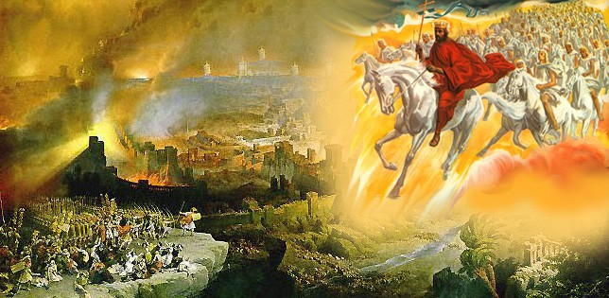
Signs of The Second Coming of Christ

Slide 12
Signs of The Second Coming of Christ
Preaching of Gospel throughout the world
Defection from the Faith (A Great Apostasy)
The coming of the AntiChrist
The Church’s Ultimate Trial (CCC 675)

Slide 13
Article 8: I BELIEVE IN THE
HOLY SPIRIT

Slide 14
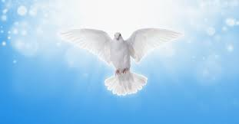
Holy Spirit: 3rd Person
One God in essence but 3 Divine Persons
- Father begotten by none
- Son begotten by Father before all ages
- Holy Spirit: Proceeds from both
Equality in Trinity
Whatever Faith Attributes to God, Belongs Equally to the Holy Spirit

Slide 15
Holy Spirit Is God
Equally Omnipotent and Eternal
Supremely Good
Infinitely Wise
Same nature with the Father and the Son

Slide 16
Titles of the Holy Spirit
Paraclete- he who is called to one’s side- helper: Advocate
Consoler and Comforter
The Giver of Life
Spirit of Glory

Slide 17
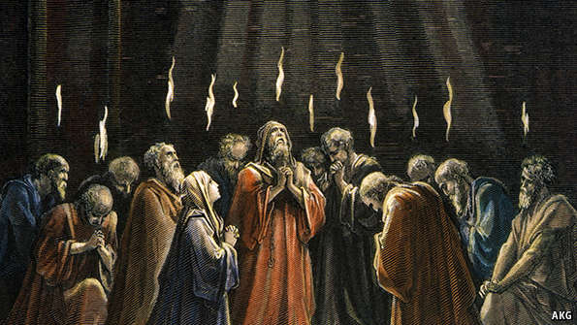
Symbols of the Holy Spirit
Fire
Water (Baptism- receive gift of Sanctifying Grace)
-Sanctify Grace: Indwelling of the Holy Spirit
- Infuses us with spiritual life; without we can do nothing meritorious of eternal life

Slide 18
Symbols of the Holy Spirit
Dove
Cloud (provides life giving water)
Wind, Breath, Air (Hebrew: Ruah)
- Genesis:1:1-2
Anointing with Oil at Confirmation

Slide 19
7 Gifts of the Holy Spirit
Counsel
Piety
Fear of the Lord
Fortitude
Knowledge
Understanding
Wisdom

Slide 20
Holy Spirit
From the gifts of the Holy Spirit we receive the rules of Christian Life and we are able to know if the Holy Spirit dwells within us.

Slide 21
Holy Spirit: Source of all Holiness
“Therefore I want you to know that no one who is speaking by the Spirit of God says, ‘Jesus be cursed,” and no one can say ‘Jesus is Lord’ except by the Holy Spirit”
1 Corinthians 12:3

Slide 22
Article 9: THE HOLY CATHOLIC CHURCH, THE COMMUNION OF SAINTS

Slide 23
The Holy Catholic Church
Jesus Christ is the Head and Founder of the Catholic Church
Founded by the God-Man: Church is sole Teaching Authority of God’s will on earth
Church’s establishment traced back to the Apostles when Jesus speaks to Peter, our first Pope:
“And so I say to you, you are Peter, and upon this rock I will build my church, and the gates of the netherworld shall not prevail against it. I will give you the keys to the kingdom of heaven. Whatever you bind on earth shall be bound in heaven; and whatever you loose on earth shall be loosed in heaven”. Matthew 16:18-19

Slide 24
The Holy Catholic Church
Jesus Christ as its head; Church His Bride
We are the Mystical Body of Christ
- describes the supernatural union that Christians have with the spiritual Body of Christ who serves as the one mediator between man and God who alone can reconcile us to the Father.
“I am the way and the truth and the life. No one comes to the Father except through me”.
John 14:6

Slide 25
Four Marks of the Church
One
Holy
Catholic
Apostolic

Slide 26
One Church
Her Source: the unity of the Holy Trinity.
The Church has one faith and one sacramental life.
“So that they may all be one, as you, Father, are in me and I in you, that they also may be in us, that the world may believe that you sent me” John 17:21
Saint Paul says :
“One Lord, one faith, one baptism; one God and Father of all, who is above all, throughout all, and in us all.”
Ephesians 4:5-6

Slide 27
One Church
One Ruler: Jesus Christ
Visible ruler on earth: The Pope
- legitimate successor of Peter, prince of the Apostles

Slide 28
Holy
United by Christ the Church is sanctified by Him.
The Church is holy because she is consecrated and dedicated to God.
All activities of the Church are directed toward the sanctification of people in Christ.
“We are all called to be great saints”
-Mother Angelica

Slide 29
Catholic
Greek for universal
Mission of the Church: Spread the Good News
“Go therefore and make disciples of all the nations, baptizing them in the name of the Father and the Son and the Holy Spirit, teaching them to observe all that I commanded you; and lo, I am with you always, even to the end of the age.”
Matthew 28:19-20

Slide 30
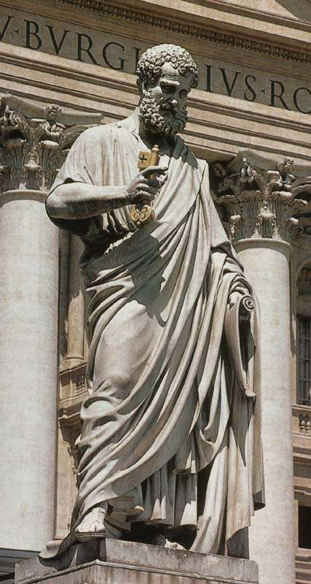
Apostolic
Christ gave authority to His Apostles and the responsibility to continue His work.
Sent forth to spread the Good News

Slide 31
Bishop Barron Podcast: 4 Marks of the Church
https://www.wordonfire.org/resources/homily/one-holy-catholic-and-apostolic/792/

Slide 32
The Communion of Saints

Slide 33
The Communion of Saints
Church is Human and Divine
All members in the Church share in the Holy Faith
Exists in 3 states (CCC 954)
Church Triumphant
The Church Penitent (Church Suffering)
All Souls’ Day (November 2nd)
Church Militant (Pilgrim Church on Earth)

Slide 34
Church Militant

